Slide 1
Speaker and Moderator Training
Collaborative and Livestream Sessions

Slide 2
Agenda
Collaborative and Livestream Session Experience
Speaker Best Practices
Moderator- Live Q&A, Polls and Chat
Zoom Overview
Available Resources

Slide 3
Collaborative and Livestream Sessions
Experience might differ while using Advanced Production- Cvent Studio

Slide 4
Livestream Sessions
Collaborative Sessions
Overview: Attendees will watch the stream from the Event Website (Virtual Attendee Hub) in an embedded video player. Each session has its own page and player.
Attendee Engagement: The presentation is a one-way stream that will begin at session start time. Attendees can only participate by asking a question through the Q&A window if enabled on your session. Only the Sessions Host/Moderator and Speakers will be in the Zoom which is broadcasting to the video player
Overview:
The session will be much like an ordinary Zoom meeting just like we are in now. Attendees will join the speakers in a Zoom Room and be able to interact directly with each other.
Attendee Engagement:
Attendees will join the Zoom session (5) minutes before the session starts. In order to control the arrival, the host can set up a waiting room to admit the session’s attendees when ready. Attendees will be able to unmute and speak up and be on Camera.

Slide 5
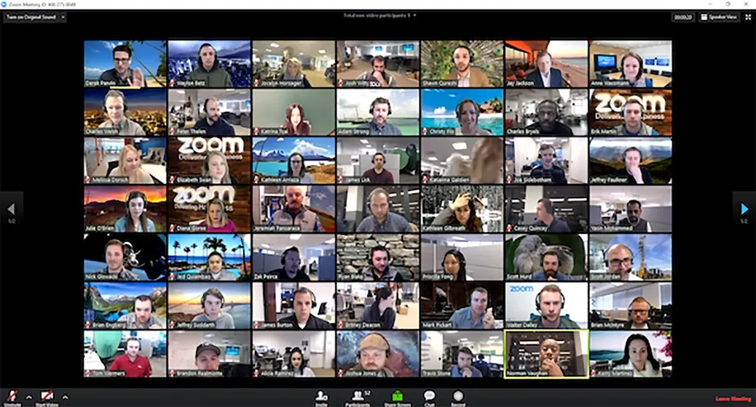
Attendee Experience Collaborative Session
Joining the same Zoom Meeting
If joining prior to session start time, they will be put in a waiting room until the host admits them.
Will have much of the same functionality as any normal Zoom meeting.

Slide 6
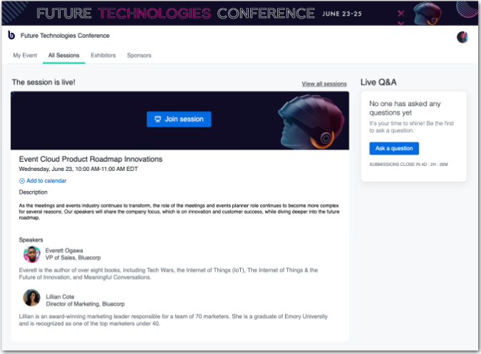
Attendee Experience Livestream Session
Attendees will stream the Session through the Video Player within the Session Details Page
They will submit Q&A through the Q&A Display section of the page

Slide 7
Presenter Experience Livestream and Collaborative Session
Pre-Event
Day Of
Prep and practice presentation materials.
Make sure your timing allows for any planned attendee interactions and stays within the session time.
Download all presentation materials to your local hard drive. Do not share any PowerPoint, pictures, or videos through a web browser. These should all be stored locally to your device.
Log in to the Virtual Attendee Hub prior to the event kickoff to familiarize with the platform functionality
You will receive an email with a Zoom Presenter URL. Use this link to join the session as the speaker.
Join your session 15 minutes prior to the session start time to meet with your host and any additional presenters. A Host will already be in the session meeting to greet you and go over a final round of AV and content checks.
Joining your session to present is much like any other Zoom Meeting.
Livestream: You will not be able to see Attendees/Participants in the Session as they will be watching through the Cvent Video Player on the attendee website. You will only see the other Speakers and AV Tech (meeting host) in the Webinar
Collaborative: Attendees will be in a "Waiting Room” until all speakers have arrived. Once the session start time is reached, the host will admit all attendees into the session room. Attendees will be able to directly interact with you in the zoom meeting.
Green Room Check-In 30 minutes prior to your session start for AV Support. (Zoom link provided the week prior)

Slide 8
Speaker Green Room
Times and locations will be confirmed closer to the event, but will be available most of the day
What is it?
It is a zoom meeting where techs will be able to perform a tech check with you. It’s extremely important that every Speaker joins and performs a tech check with the green room support staff.
What will we do?
The Green Room support tech will go over audio, video, and content checks with you.
Why do we join?
This is the best way to mitigate risk of having tech issues during your session!

Slide 9
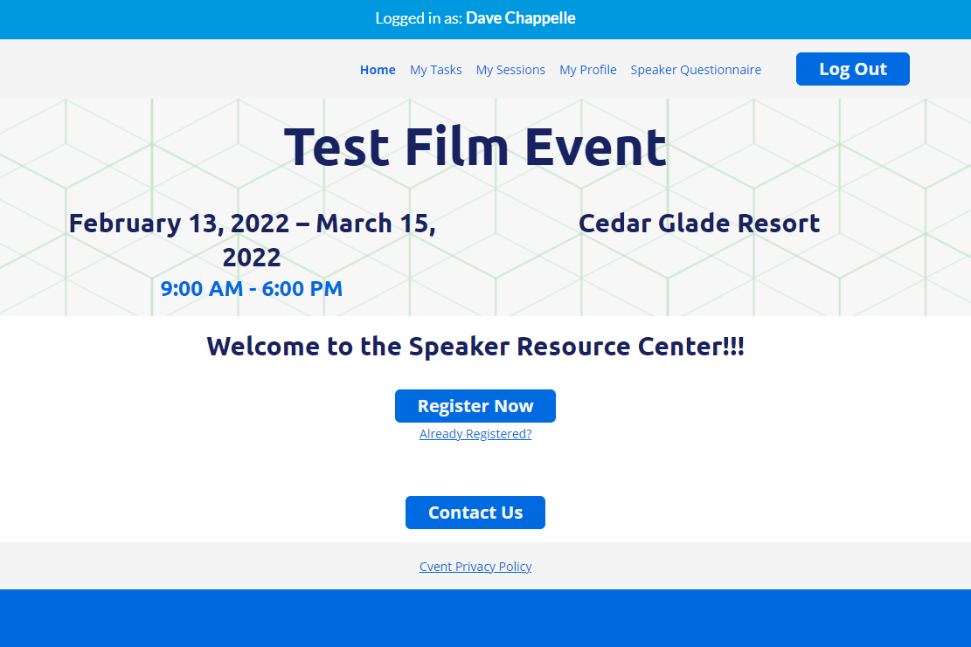
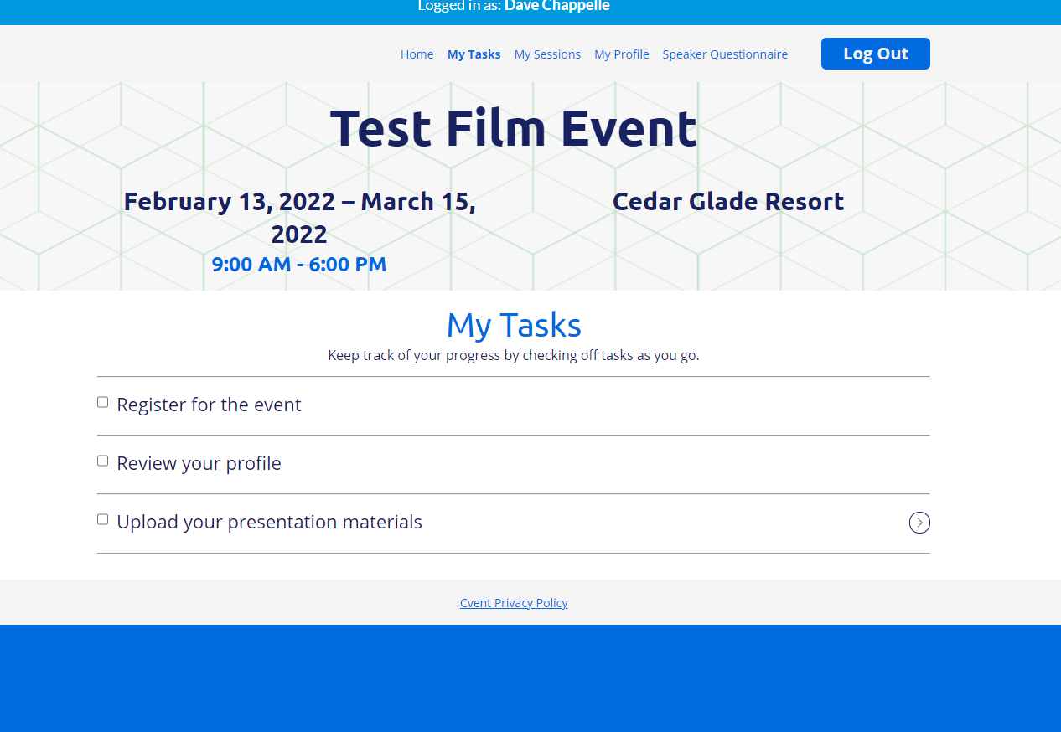
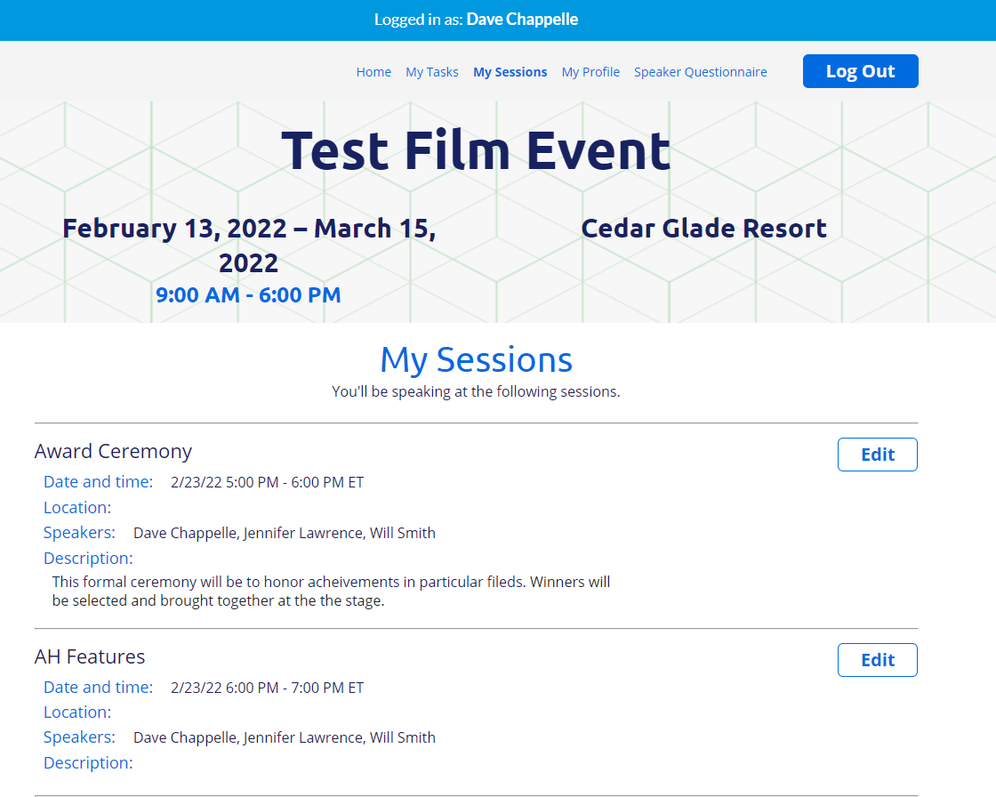
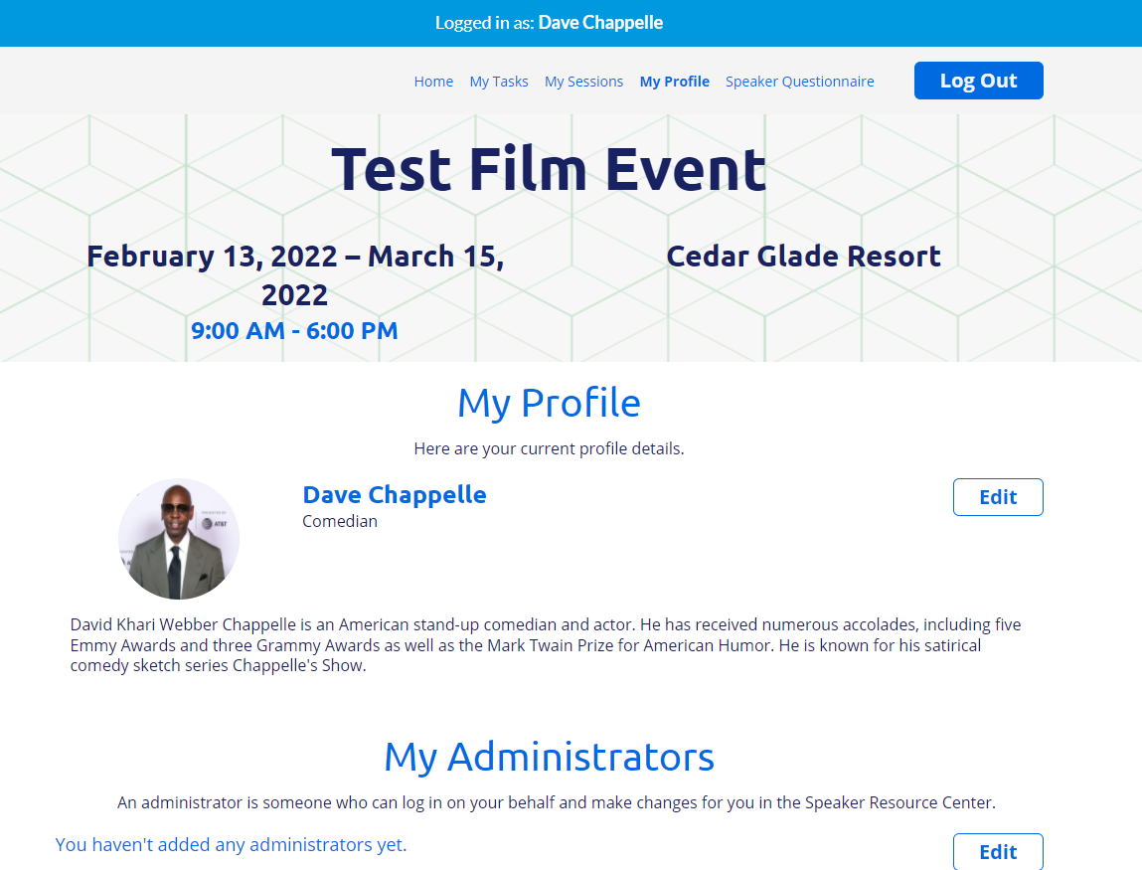
Speaker Resource Management

Slide 10
Speaker Best Practices

Slide 11
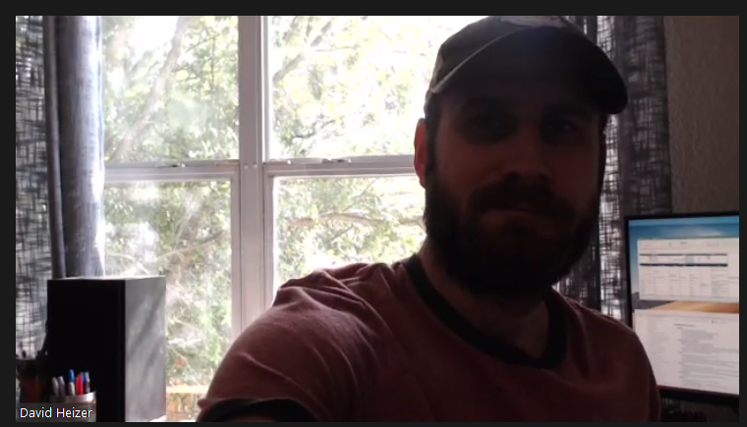
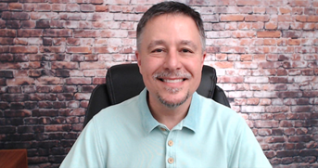
Speaker Do’s & Don'ts Lighting & Video
Use natural lighting to brighten the room (try being close to or sitting facing a window)
Use enough front light so your face is clearly visible
Try placing a lamp behind your webcam
Too much light behind you will wash out the video
Bad preview = bad presentation
If a webcam looks better than your computer camera, use it
Camera should be positioned at eye level
You should be centered in the frame, edge of both shoulders visible, eyes in the top third of the frame
The background should not be distracting, move any clutter out of frame

Slide 12
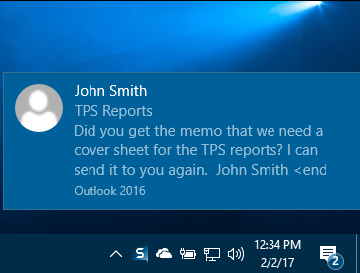
Speaker Do’s & Don'ts Audio
•Make sure to present from a room with minimal echo
•Ensure nothing distracting is happening around you
•Sounds to look out for: AC/Heaters, Refrigerator, Children and Pets, Traffic, TV’s, Radios, Construction
•We recommend using USB mics or headset mics.
•Laptop mics are okay if necessary
•Earbud mics are NOT recommended
•Make sure your microphone is adjusted and working correctly
•Notifications are turned off (Outlook, Slack, etc.)
•Silence your cellphone for incoming calls, text, emails
•Close all non-conference related programs / applications on your computer

Slide 13
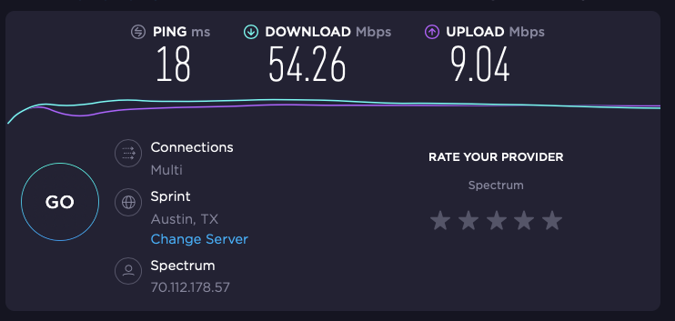
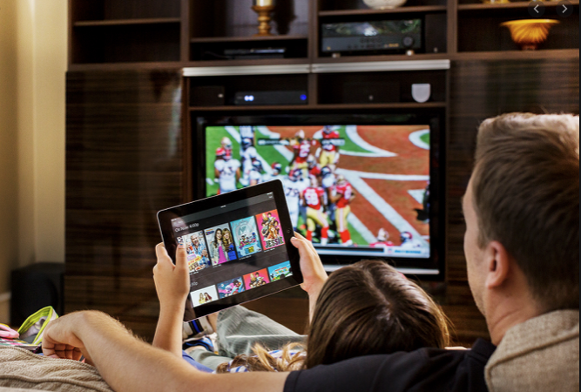
Speaker Dos & Don'ts Networking
Internet speed should be at least 6 mbps up/down
We recommend that you plug your computer directly into the router using an Ethernet cable
If your internet is unstable, try moving closer to your router
Be mindful of who else is using the same network, no one should be downloading or streaming video during your presentation
Do! - Connect your computer via a hardline and check your internet speed!
Don't! Let others hog your internet!

Slide 14
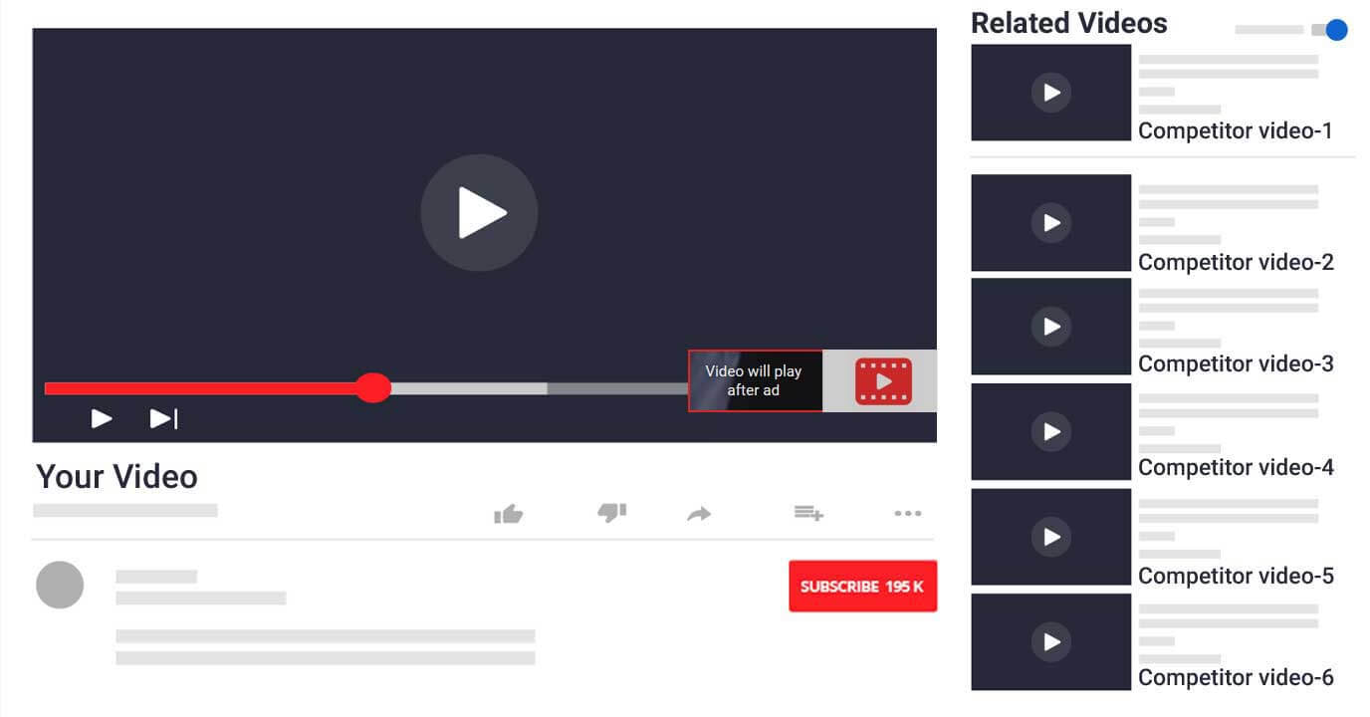
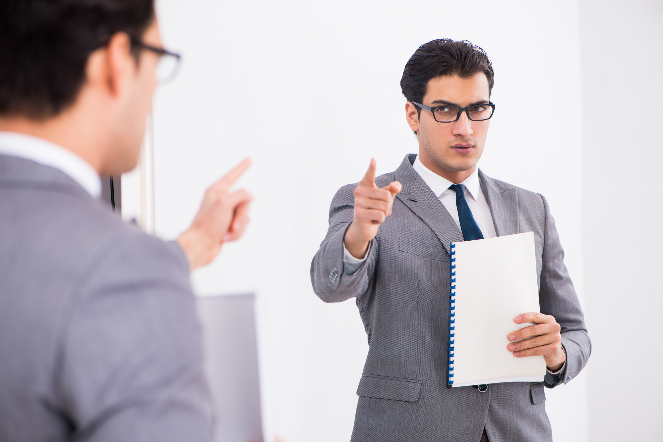
Speaker Do’s & Don'ts Content
Sharing
Make sure all content is downloaded and saved to your computer locally
Do not share content from any online source
If you are planning on sharing videos, make sure they are downloaded, not streamed from an online source
Rehearse
Know your content and maintain eye contact with the camera
Keep your eye on the time
Be comfortable sharing content and managing Zoom features, if using

Slide 15
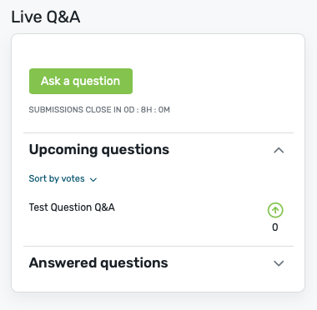
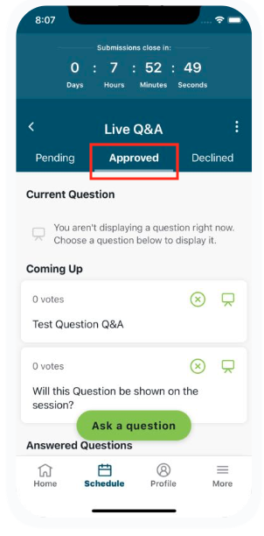
Live Q&A
Q&A will be through the Attendee Hub website (not through Zoom)
Attendees will be able to ask questions from the session page, next to the video player.
Questions can be answered aloud or can be answered via written response.
The Q&A Moderator will need to approve questions for them to display on the Website

Slide 16
Moderator Training
Live Q&A, Polls and Chat

Slide 17
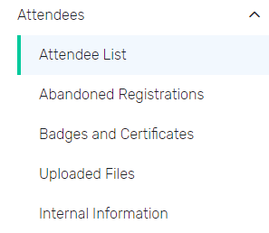
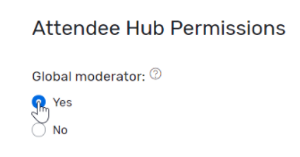
Assigning Global Moderator
You can designate attendees who should have access to monitor session chat, live Q&A, and polls for every session in your event.
Step 1: Navigate to the Attendee List: Select your event. From the left-hand navigation, click Attendees, then Attendee List.
Step 2: Assign global moderators: Click the name of the attendee you want to designate as a global moderator, then click Edit.
Under Attendee Hub Permissions, set Global moderator to Yes.
Click Save. To assign more global moderators, click Close, then repeat this action for each attendee who should be granted these permissions.

Slide 18
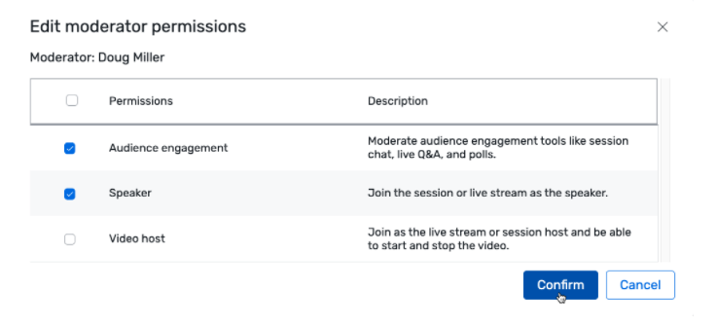
Assigning Session Moderator
You can designate attendees as hosts, speakers, or monitors for session chat, live Q&A, and polls for specific sessions in your event.
Step 1: Navigate to the Session List- Begin by selecting your event. From the left-hand navigation, click Agenda, then Session List.
Step 2: Assign session moderators- Locate the relevant session and click its name. The Details tab opens by default. Click the tab to the right, Attendee Hub, then Edit. In the Approved Moderators section, click Assign moderators. Filter the attendee list by searching for an attendee's name, and click the checkbox next to each attendee you want to add as a moderator for the session. Click OK.
The attendees you selected will be assigned the "Audience engagement" permission by default. This allows them to moderate engagement features like session chat, live Q&A, and polls.
If you want to remove a session moderator, click the Trash Can Icon icon next to their name. Keep in mind that global moderators cannot be removed from an individual session. Once you're done, click Save.
NOTE: Any global moderators you've previously assigned to monitor audience engagement for your event will already be listed.

Slide 19
Moderator Roles & Responsibility
Session Types
Moderator Role
Overview:
You will moderate Live Q&A and Session Chat in the Attendee Hub as well as join the Zoom room for live sessions.
Session Features:
Live Q&A: Questions from attendees will appear in the Virtual Attendee Hub. Your job as moderator is to review, approve and display attendee questions. Once you approve a question, you’ll then be responsible for relaying the question to your speaker during the session. Moderators can also provide written responses within the Attendee Hub.
Chat: In the Attendee Hub you can delete inappropriate chats as needed.
Livestream: The presentation is a one-way stream. Attendees will watch the stream from the Attendee Hub website in an embedded video player and not be visible in the Zoom room.
Experience might differ while using Advanced Production- Cvent Studio

Slide 20
Moderator Experience – Livestream Sessions
Pre-Event
Day-Of
Log in to the Attendee Hub prior to the event to familiarize yourself with the platform functionality
Ensure you can locate and access your session(s)
Verify you have access to join your session 48 hours before the event.
Log into Attendee Hub in your browser at least 30 minutes prior to the session start and navigate to your Session Page. This is where you will be managing Live Q&A and Session Chat.
Do not play the session’s video in Attendee Hub while you are in the Zoom room.
Join your session in Zoom room at least 30 minutes prior to the session start time
Only speakers and tech support will be in the meeting (Attendees will watch the session on the Attendee Hub website)
You will relay the questions from Attendee Hub to the speakers by sending through chat in the Zoom room.
There will be a 30-second delay between the speakers in Zoom room \and the livestream video in the Attendee Hub
Be aware that when attendees are prompted to submit question there will be that delay

Slide 21
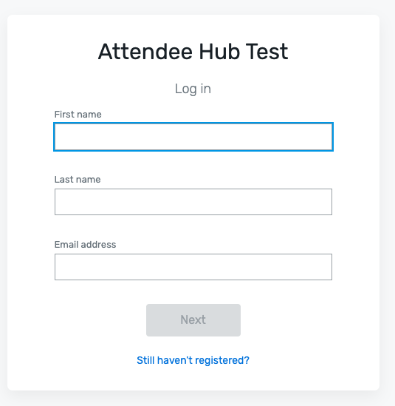
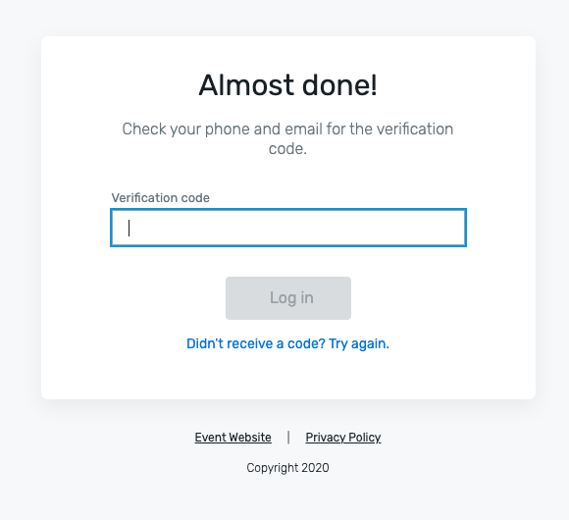
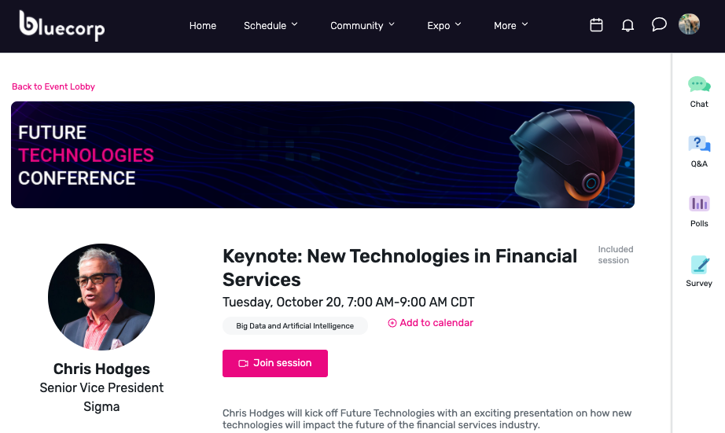
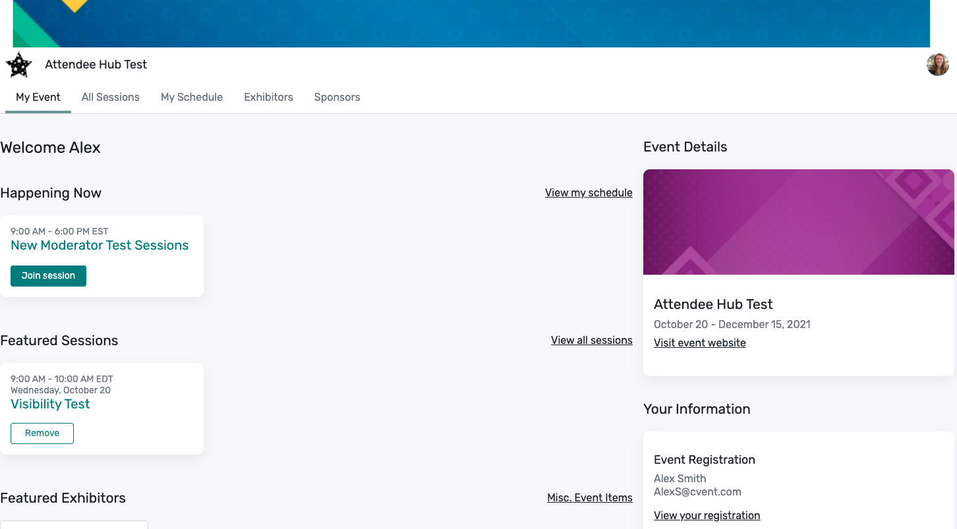
Livestream Sessions
Attendees will not be in Zoom with you
The Session will be streamed through the Video Player within the Session Details Page
Attendee Experience: Login and Homepage
1
2
4
3

Slide 22
Moderating Live Q&A

Slide 23
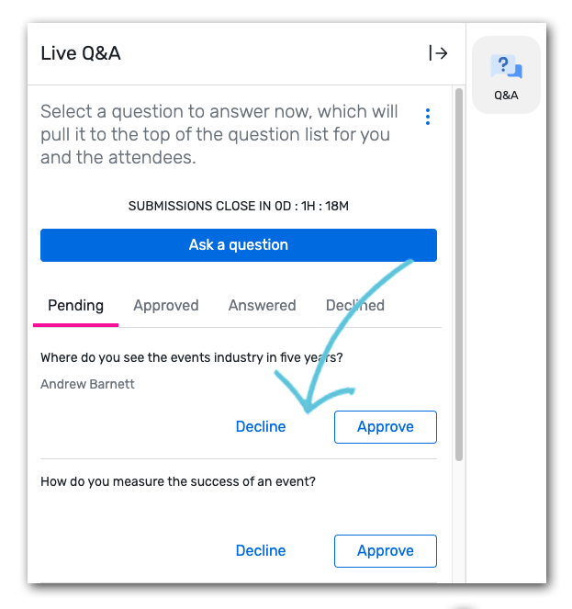
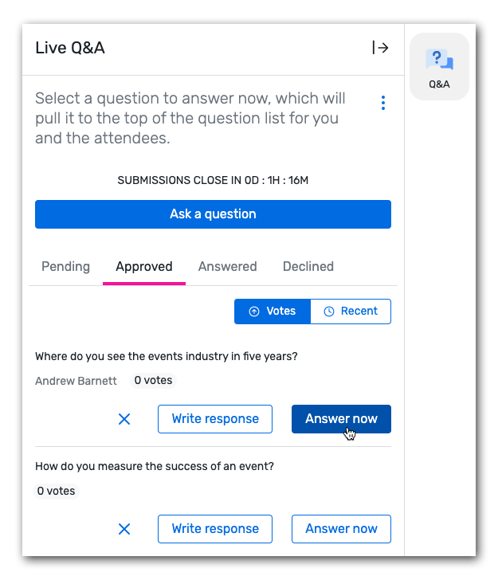
Moderating Live Q&A in the Attendee Hub
Access the session page. Begin by logging in to the Attendee Hub. Locate and click into your session.
Open the Q&A Icon to start moderating questions. Click Q&A on the righthand engagement panel. The Pending tab is selected by default and displays all the questions that have been submitted.
View question submissions in “pending” tab
Approve or decline questions
There is a limit of 150 approved questions.
Attendees will not know if a question is declined
Attendees can only see approved questions
Submit a question yourself. Moderator questions are automatically approved

Slide 24
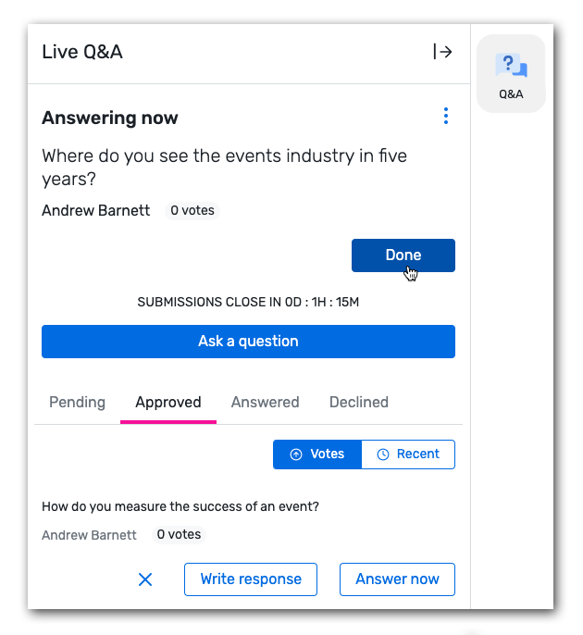
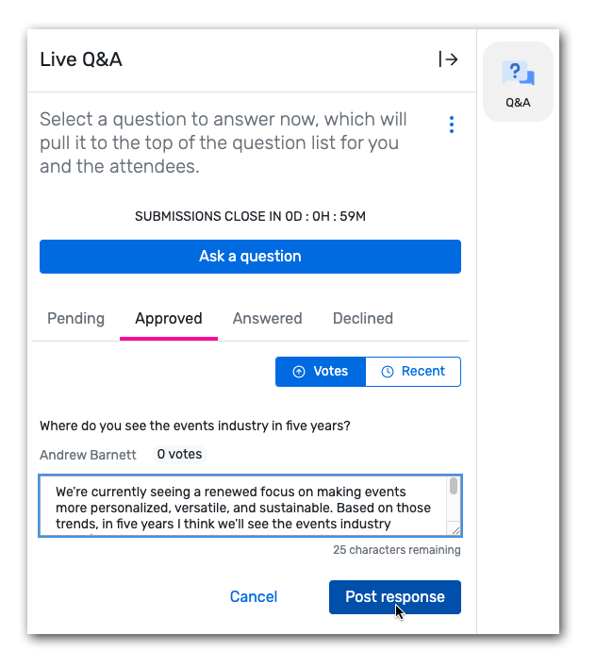
Moderating Live Q&A in the Attendee Hub
Relay the approved questions to the Speaker.
Send questions in Zoom chat by copying the questions from Attendee Hub and pasting in the Zoom chat for the speakers to verbally answer
Click “Answer Now” to display questions currently being answered by the Speaker. This informs attendees which question is currently being answered
Click Write response next to a question and type your answer in the textbox. When you're finished, click Post response.
Click “Done” to remove question from display.
This is an optional step. Selecting “Answer Now” on the next question will remove the previous question

Slide 25
Moderating Live Polls

Slide 26
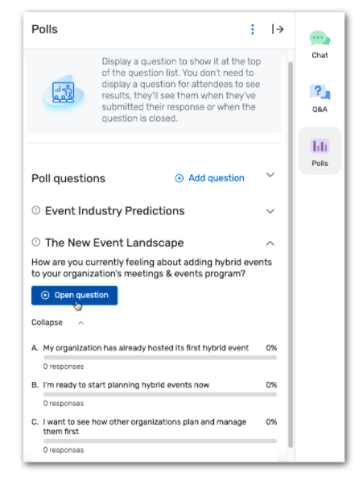
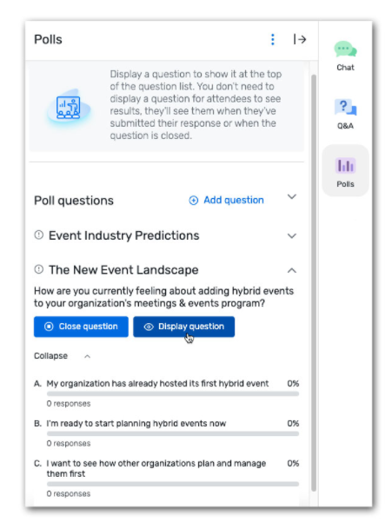
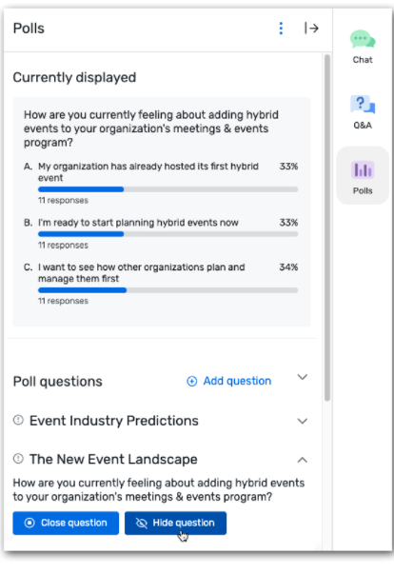
Moderating Live Polls
Begin by logging in to the Attendee Website. Locate your session on the schedule and click its name.
In the toolbar on the right, click Polls. You'll see a list of the available polls, both planner-created and self-created, and the questions each poll contains.
When you're ready for attendees to start submitting their responses, click Open question below a question. Attendees won't be able to see the question at all until you do.
Click Display question below a question to show it as the current question on the Attendee Website.
When the current question should no longer be displayed, click Hide question.
When attendees should no longer be able to submit responses to a particular question, click Close question.
Attendees will be able to view the question responses once they've submitted their own answer, or once the question is closed.

Slide 27
Moderating Session Chat

Slide 28
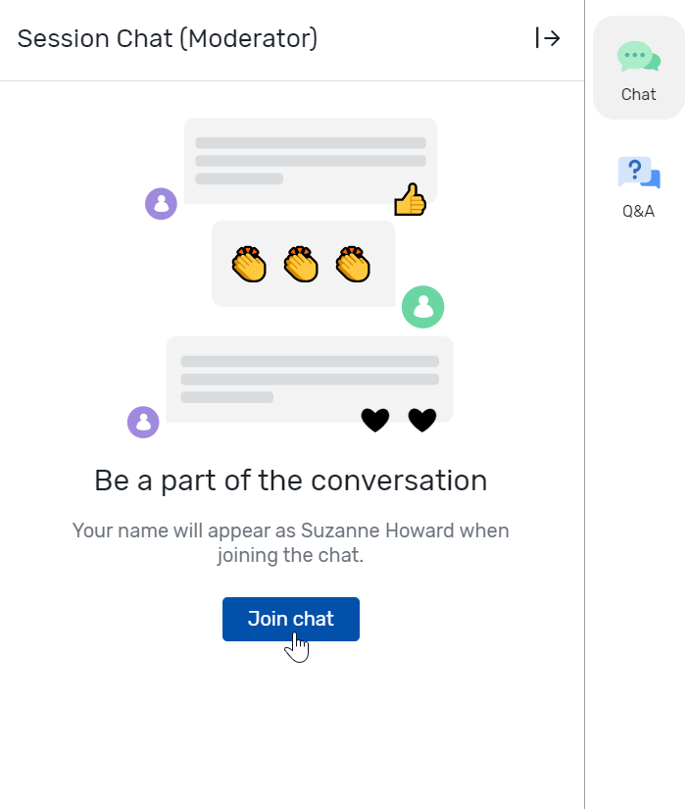
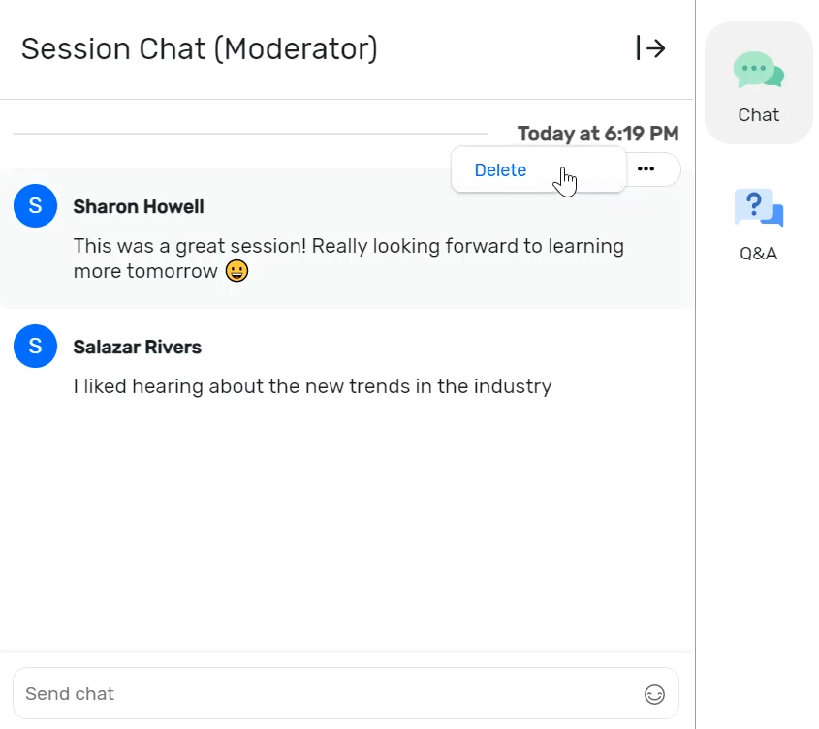
Moderating Session Chat
Access the session page. Begin by logging in to the Attendee Website. Locate and click into your session.
Open session chat by clicking Chat on the righthand engagement panel. Click Join chat to view and moderate the conversation.
Start moderating messages. As a moderator, you can send your own messages and delete inappropriate ones.
To delete a chat message, hover over the message and click the ellipsis (...). Then click Delete.

Slide 29
Zoom Overview

Slide 30
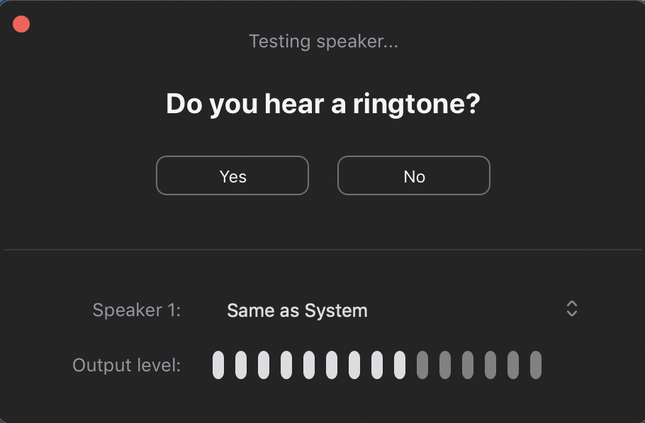
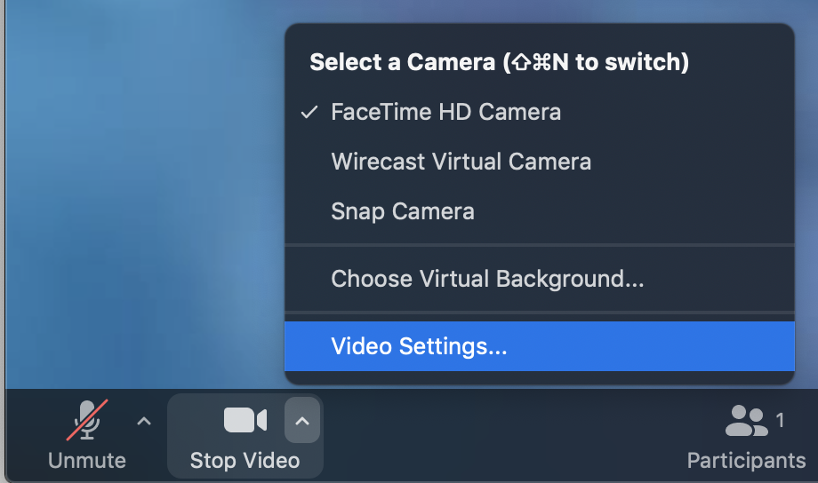
Zoom Features for Collaborative and Livestream Sessions
Livestream:
Screenshare
Chat -use the Chat to communicate with others in the zoom room (attendees will not be able to see this chat)
Use of Video & Audio
Zoom Overview (More Details in Links)
•How to Test your Audio
•How to Test & Change your Video
•Sharing Content
•Playing Videos within a screenshare
•Rename Yourself

Slide 31
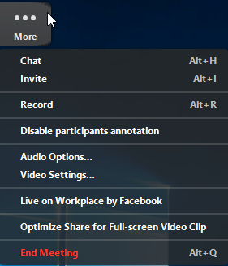
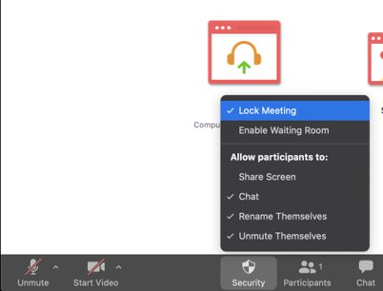
Zoom Features Collaborative Session
Feature Availability:
Waiting Room
Chat
Breakout Rooms
Screen Share
Annotation
Whiteboard
Meeting Reactions

Slide 32
Available Resources
Zoom Resources
Test your Audio
Test your Video
Sharing Content
Create a free Zoom account
Download Zoom Client for Meetings
Moderator Guides
Moderating Live Q&A on the Attendee Hub Website
Moderating Live Polls on the Attendee Hub Website
Moderating Session Chat on the Attendee Website
Article
Preparing to Speak at a Virtual Session
Speaker Training Folder Includes
Recording of today’s call
Copy of today’s PPT deck
Cvent Virtual Attendee Hub Speaker Guide
Don’t forget to reference the best practices and checklists on the next slides when preparing!

Slide 33
Best Practice Tips
Turn off Wi-Fi and connect with ethernet. Be sure to disconnect from VPN. Your internet speed should be at least 6 mbps upload and download.
Close all non-essential applications and browser tabs
Use an external webcam and proper lighting such as a ring light.
Use an external microphone and avoid environments with background noise.

Slide 34
Ready Your Device & Connect To The Internet
Have your device fully charged and connected to a stable internet connection.
Download Zoom on the device you will be using and sign up for an account if you do not already have one. **There are no dial-in options for sessions

Slide 35
Practice Tech Check
Same Environment as Event Day
Mute/Unmute
Video On/Off
Participant Rename
Network Speed Test
Chat Functionality
Screenshare (if applicable)

Slide 36
Day of Speaker Checklist
Use the below check list to set you up for virtual success. You've got this!
Limit Background Noise
Be sure to mute notifications on your computer
Silence your cell phone
Dress Professional
Avoid busy prints
Think About Lighting
Check Your Background
Plug Your Computer Into a Power Source
Confirm You Have Your Speaker URL
Test Your Internet Connection
Internet speed should be at least 6 Mbps
Connect via ethernet
Disconnect from your VPN
Close all other applications
Rehearse Your Presentation
Join the Speaker Greenroom 30 minutes Prior To Your Session Start for a Tech Check
Join your Session 10-15 minutes prior to your Session Start

Slide 37
Thank You!

